Slide 1
Custom Galactic Marine
Hoth Sentry Tower
By Shawn Layden

Slide 2

My Galactic Marine

Slide 3

My Marine with His Chaingun

Slide 4
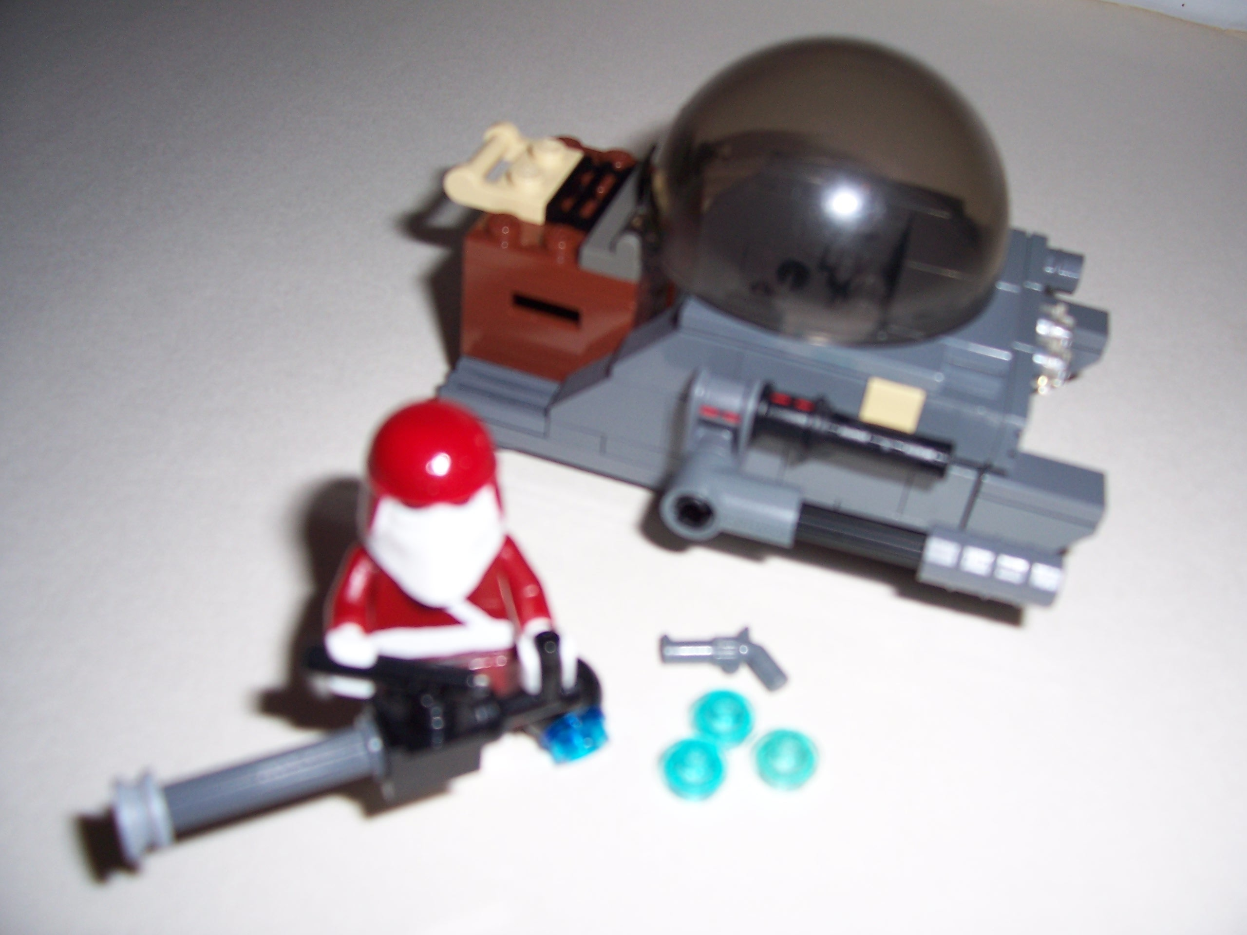
My Marine with Supplies and Tank

Slide 5

AT-RP (all terrain repulsorlift pod)

Slide 6
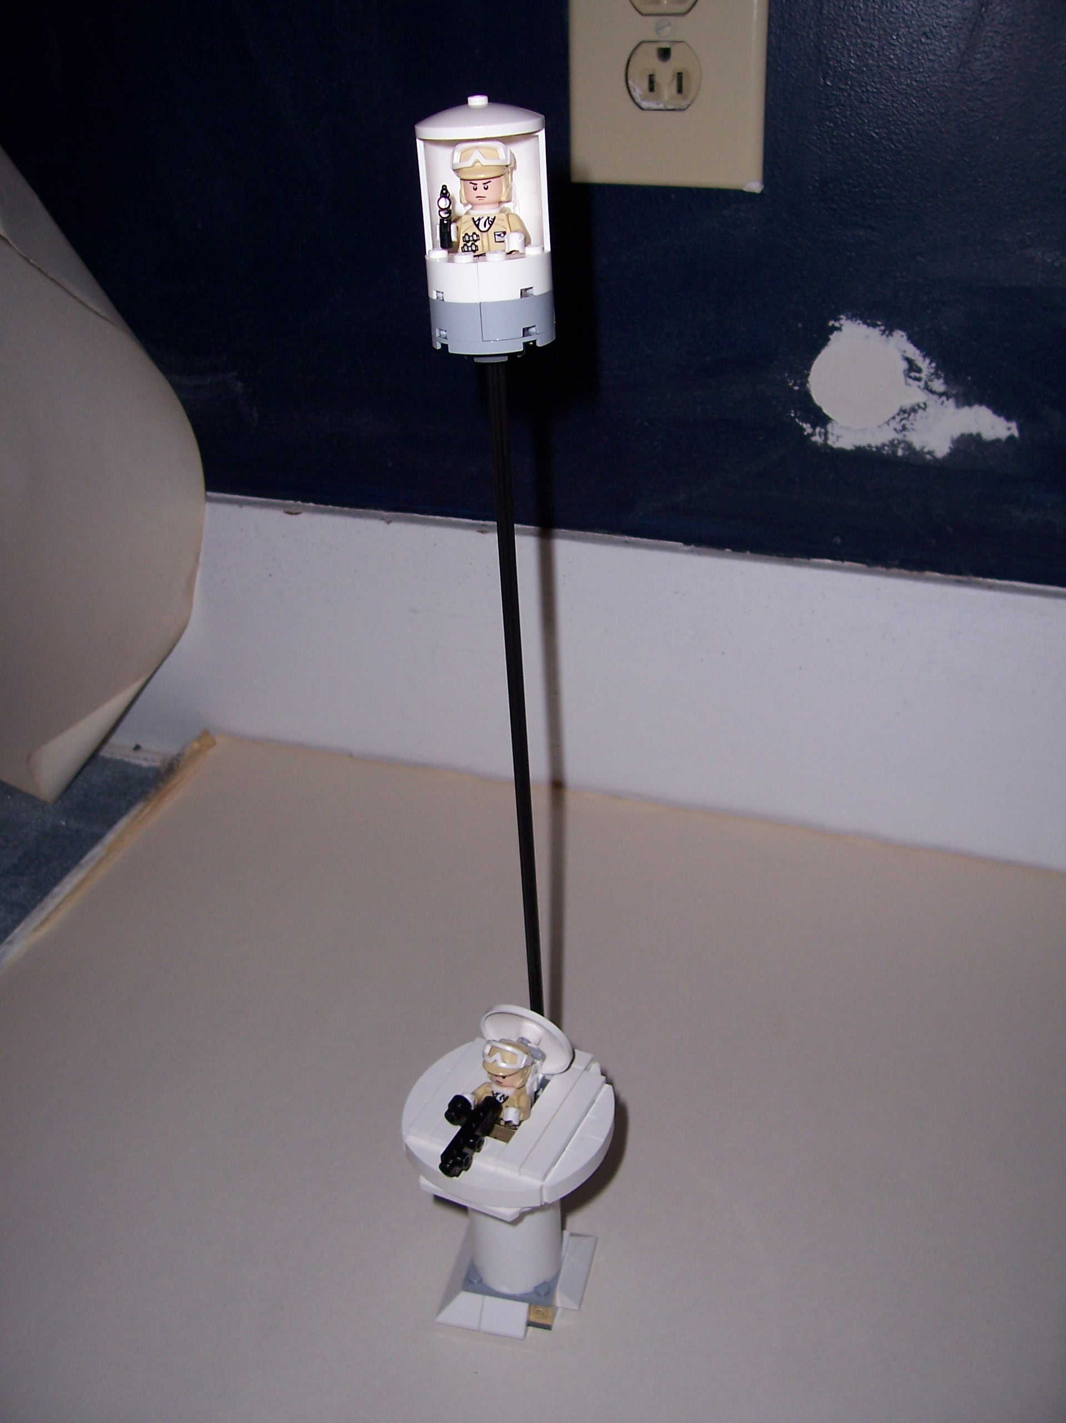
My Hoth Sentry Tower

Slide 7
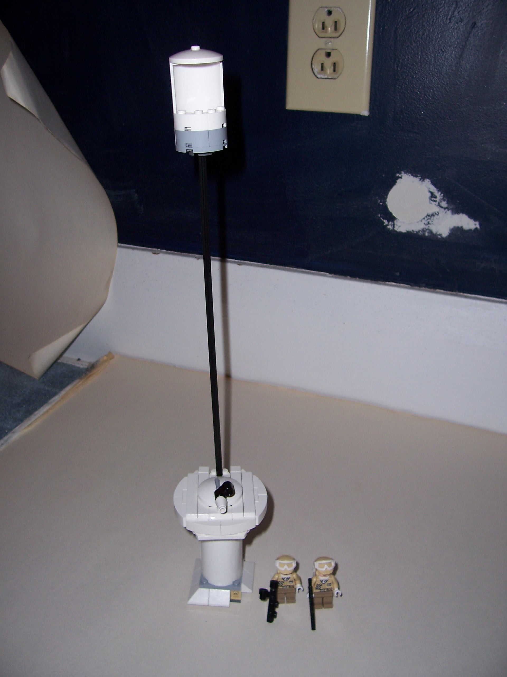
My Empty Sentry Tower

Slide 8
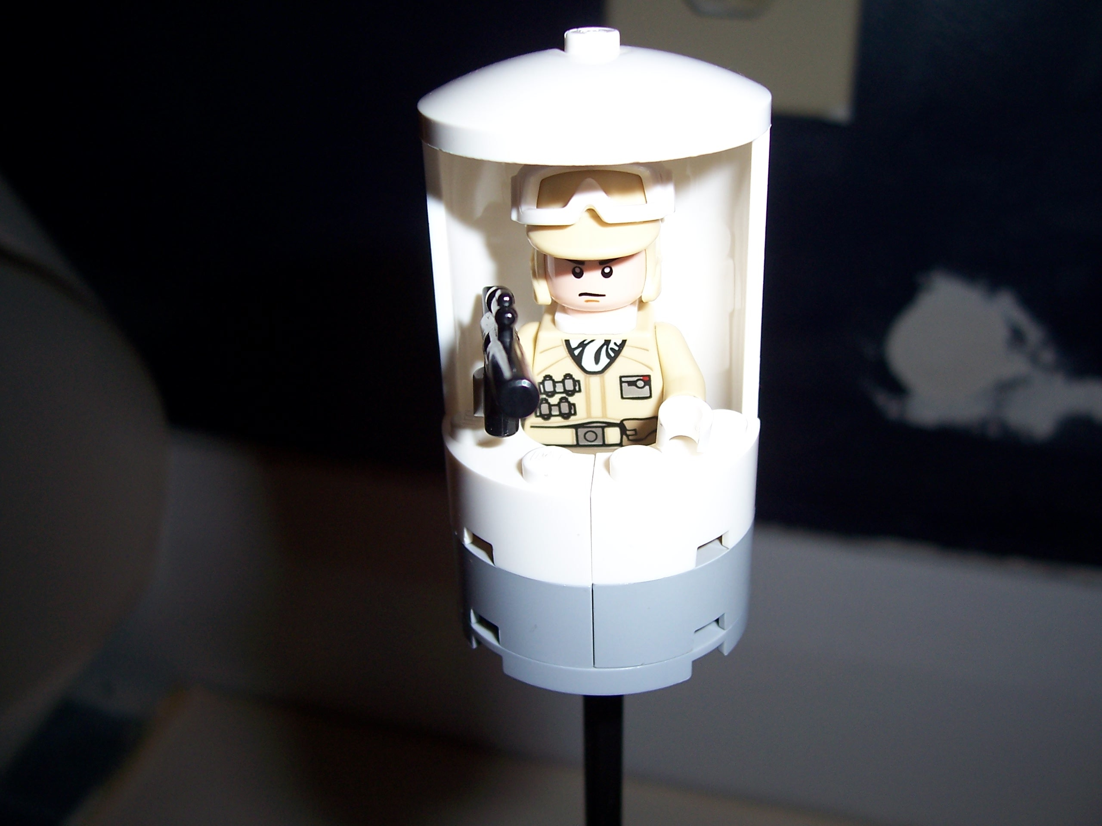
The Top of my Sentry Tower

Slide 9
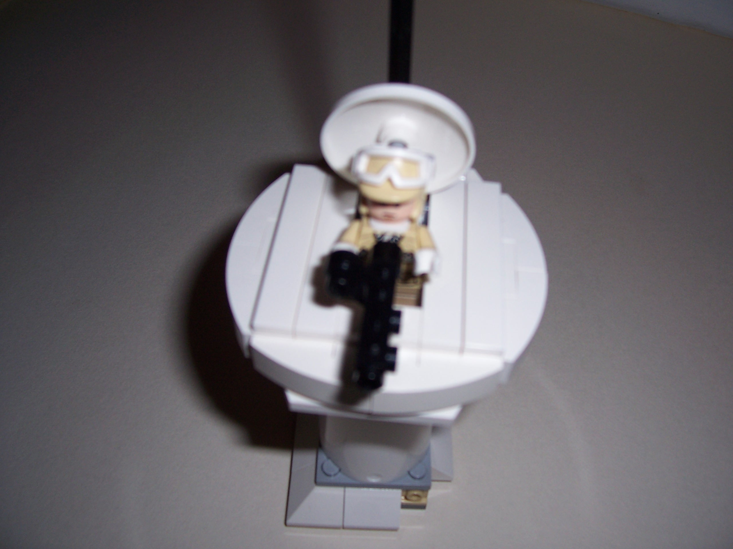
The Bottom of my Sentry Tower

Slide 10
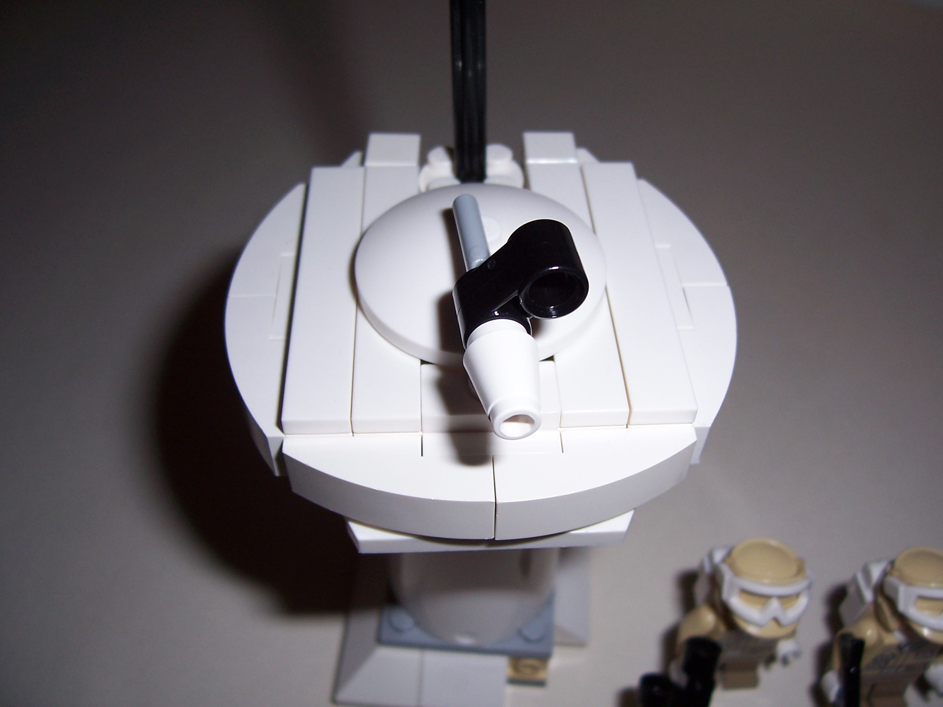
The Empty Bottom of my Sentry Tower

